Slide 1


Image Classification using Artificial Neural Network
James Ng
2019-09-27

Slide 2

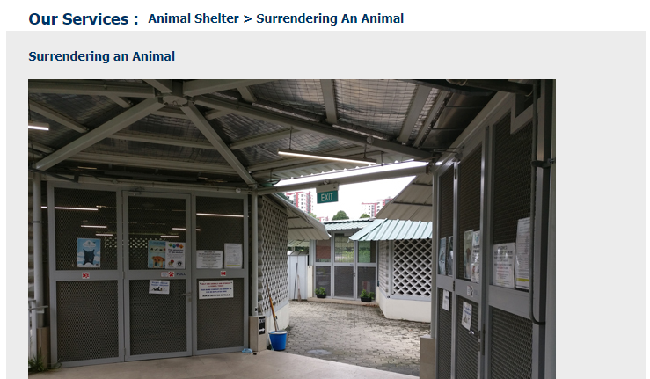
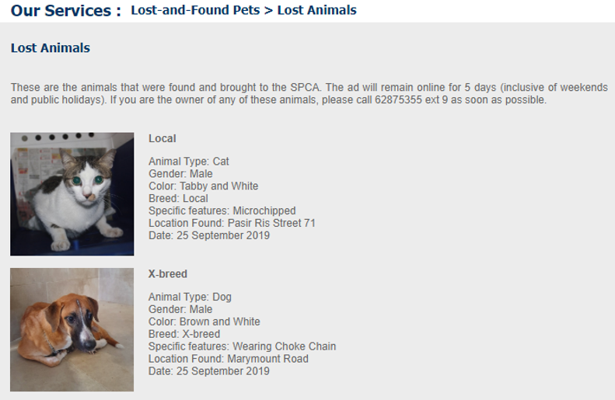
7,000 to 9,000
animals each year

Slide 3



Slide 4

Project Goal
Identification of pet breeds
Society for the Prevention of Cruelty to Animals
(SPCA)
Identification of bird species
National Parks Board
(NParks)

Slide 5

Approach
Image classification
Simple neural network model
Convolutional Neural Network model
Transfer Learning using VGG16

Slide 6

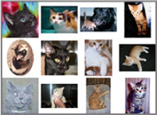
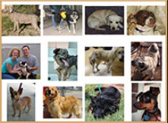
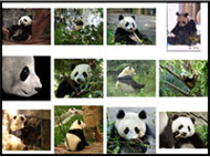
Image classification – simple neural network
3 classes
Cat
Dog
Panda
2400
training images
600
testing images
Dataset:
pyimagesearch
Notes:
May require more than one slide

Slide 7
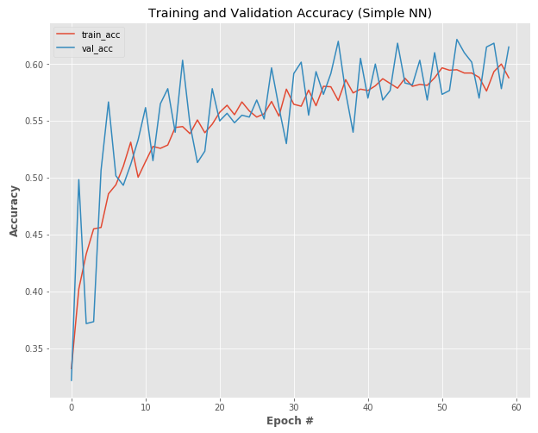
Classification results
Training time = 4 minutes
Accuracy = 61%

Slide 8
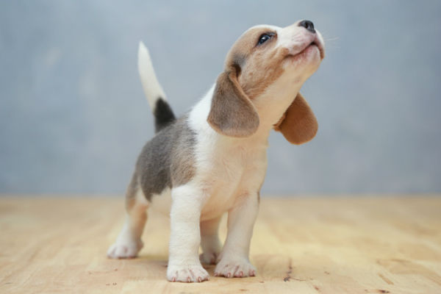
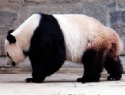
Classification results

Slide 9
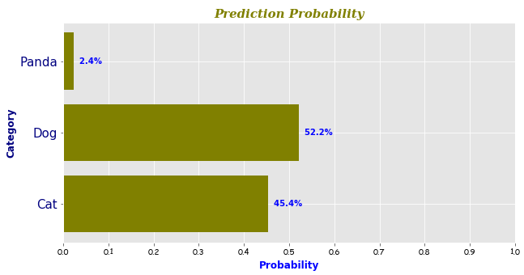
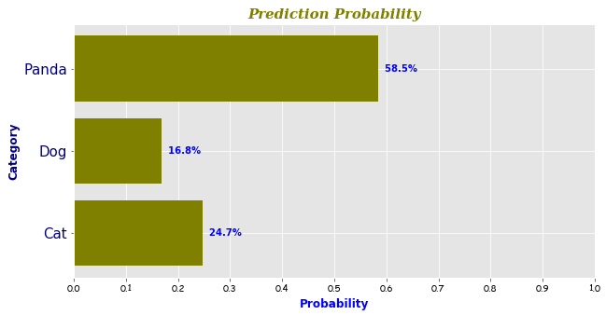
Classification results
Dog 52.2%
Panda 58.5%

Slide 10


Classification results

Slide 11
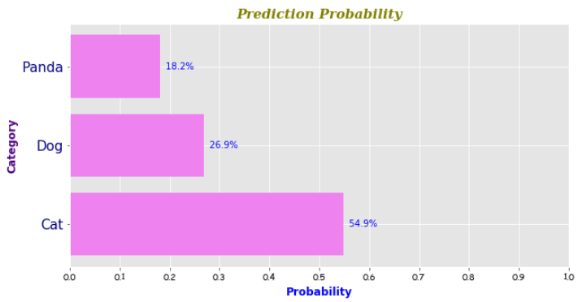
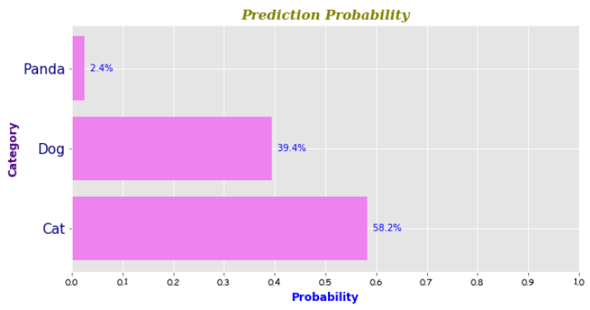
Classification results
Cat 54.9%
Cat 58.2%

Slide 12
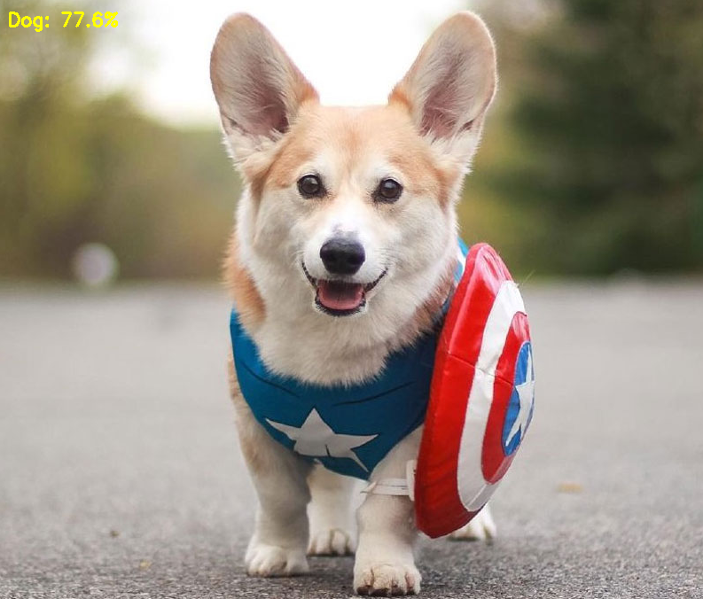
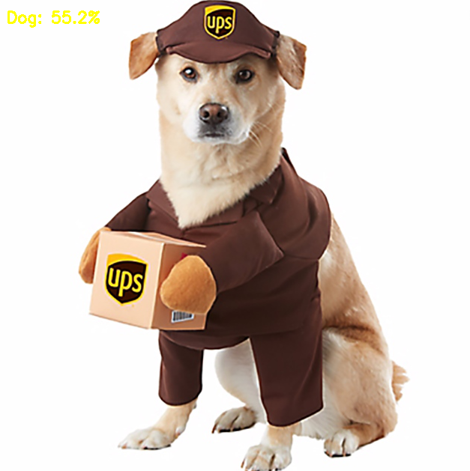
Classification results

Slide 13
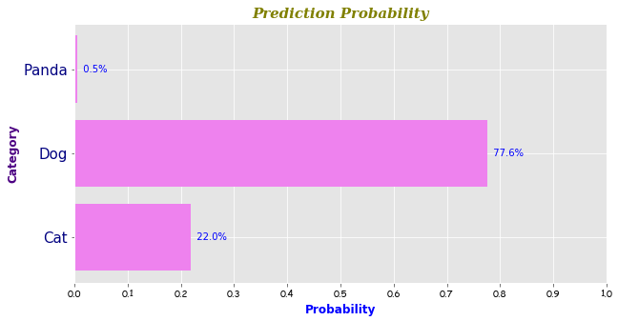
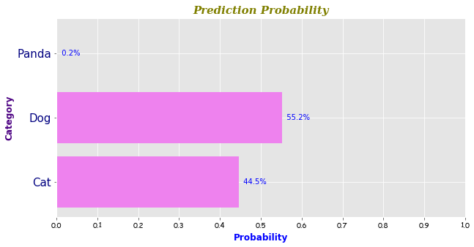
Classification results
Dog 77.6%
Dog 55.2%

Slide 14
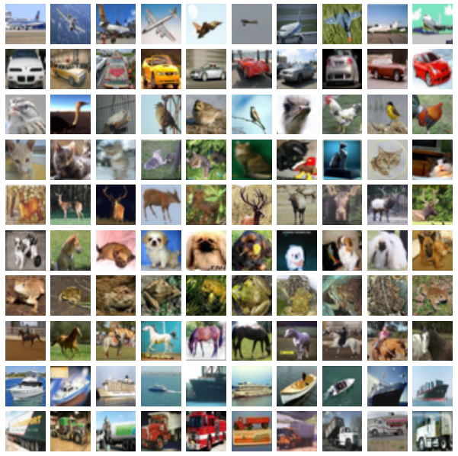
Image classification – convolutional neural network
10 classes
Airplane
Car
Bird
Cat
Deer
Dog
Frog
Horse
Ship
Truck
50,000
training images
10,000
testing images
Dataset:
CIFAR-10
Notes:
May require more than one slide

Slide 15
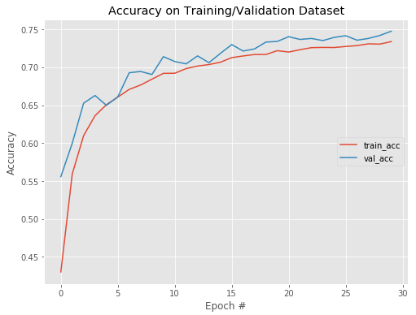
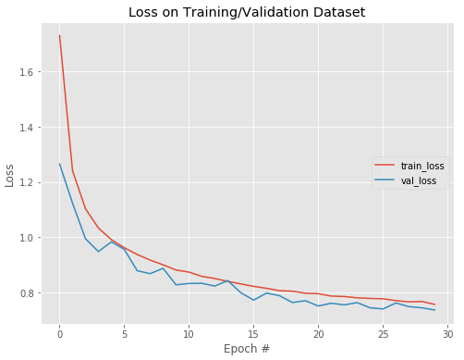
Classification results
Training time = 4 hours
Accuracy = 75%

Slide 16
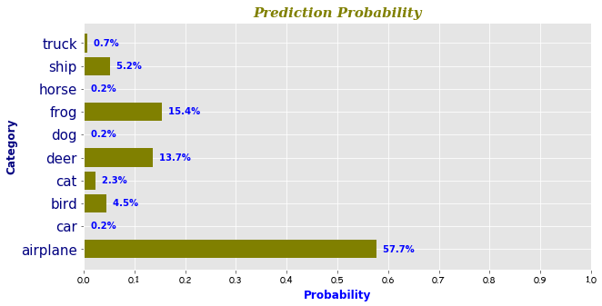
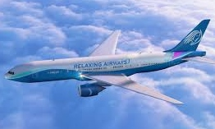
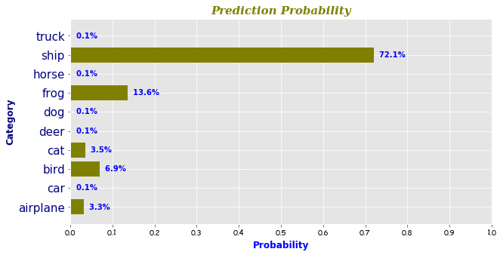
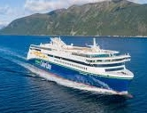
Classification results
Airplane 57.7%
Ship 72.1%

Slide 17
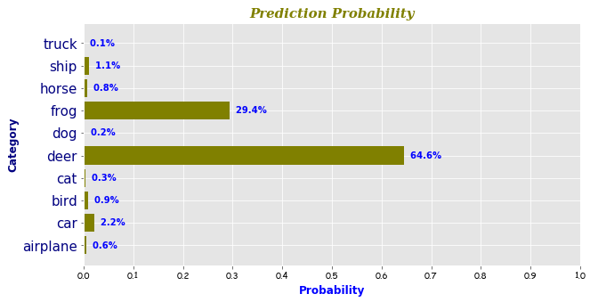
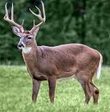
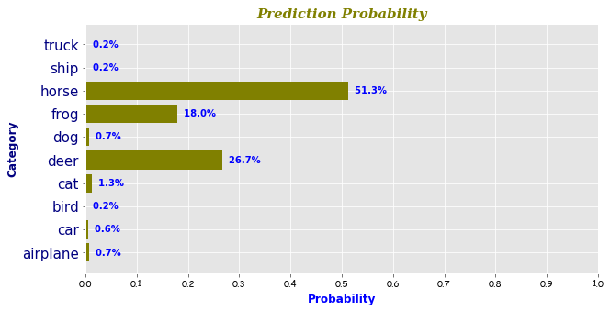
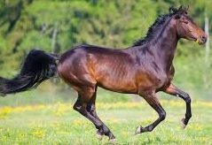
Classification results
Deer 64.6%
Horse 51.3%

Slide 18
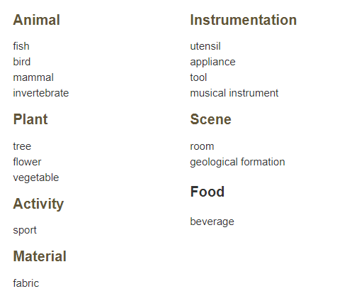
Image classification – transfer learning
1000 classes
1,200,000
training images
150,000
testing images
Pre-trained model:
VGG16
Notes:
May require more than one slide

Slide 19
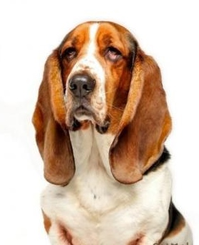
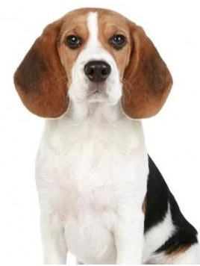
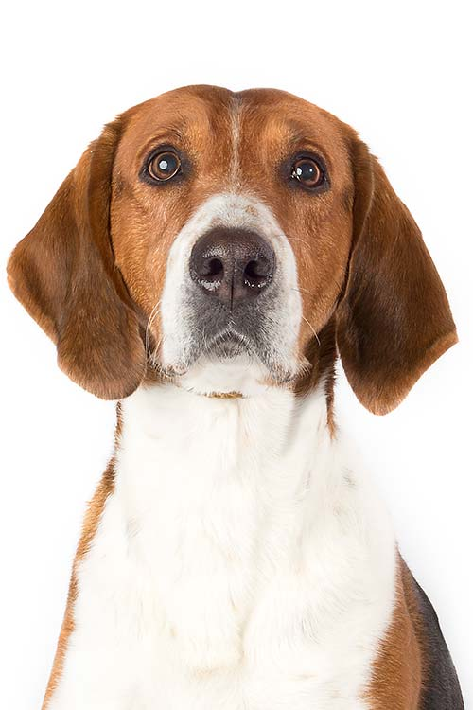
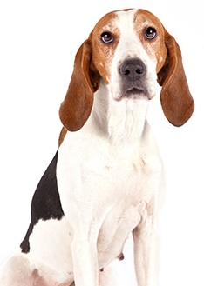
Classification results

Slide 20
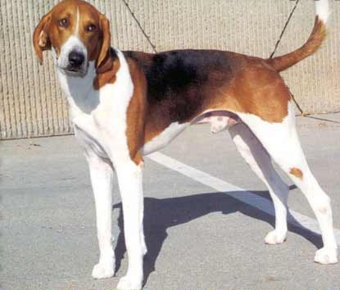
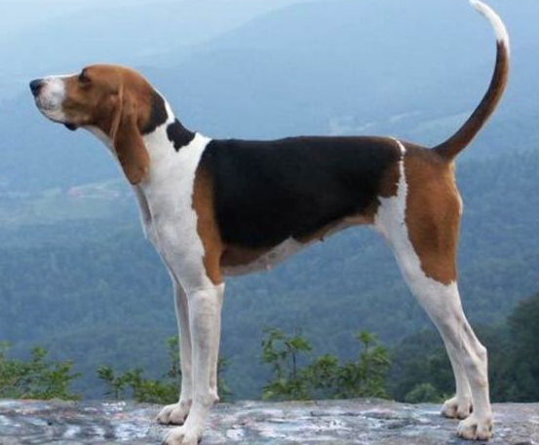
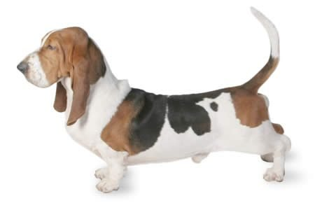
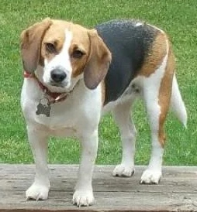
Classification results
English foxhound 48.4%
Walker hound 51.4%
Basset 79.6%
Beagle 56.5%

Slide 21
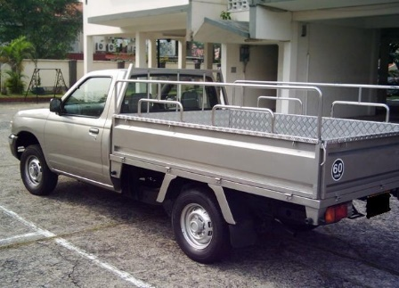
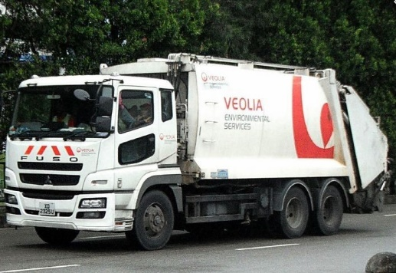
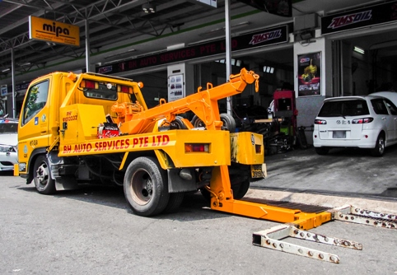
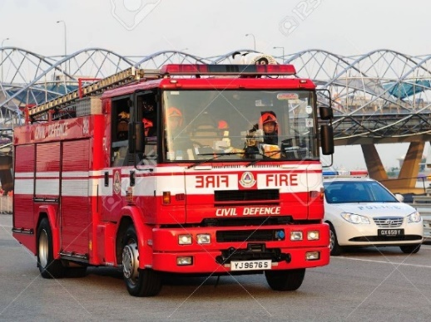
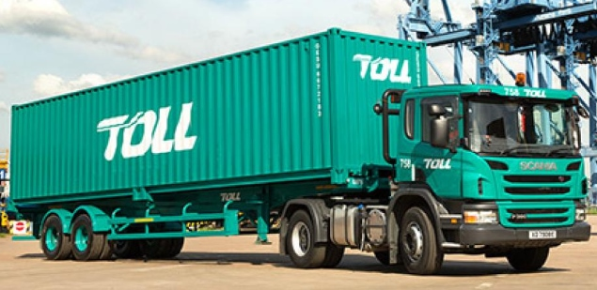
Classification results

Slide 22
Classification results
Pickup truck 97.2%
Garbage truck 99.6%
Tow truck 76.4%
Fire truck 99.1%
Trailer truck 76.3%

Slide 23
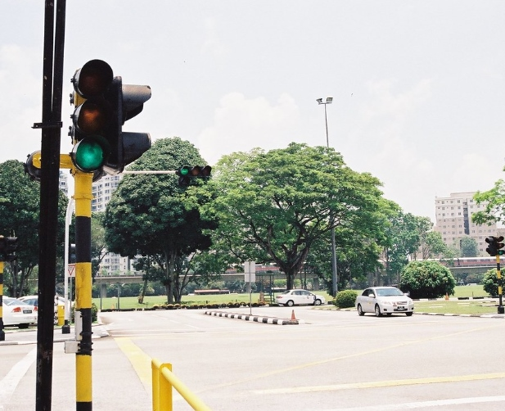
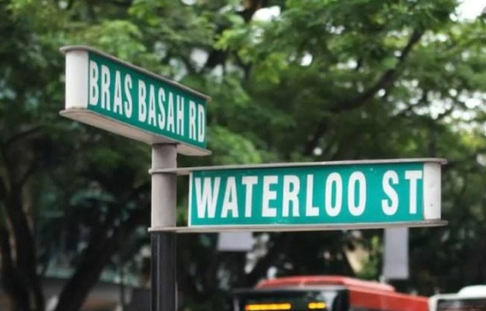
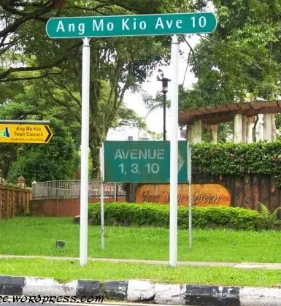
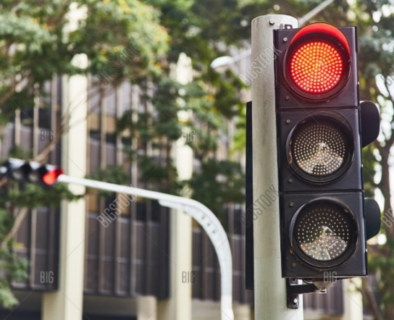
Classification results

Slide 24
Classification results
Street sign 97.3%
Traffic light 97.3%
Street sign 98.5%
Traffic light 99.9%

Slide 25

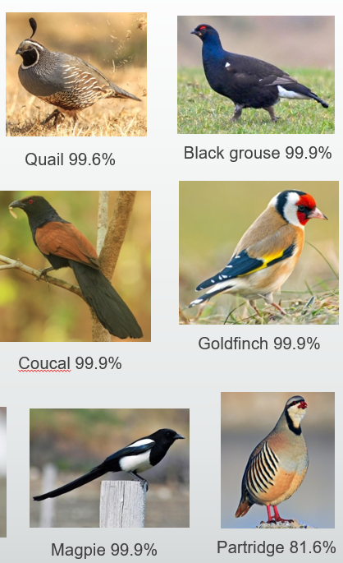
Next Steps
Develop an app for bird enthusiasts to identify breed of birds

Slide 26
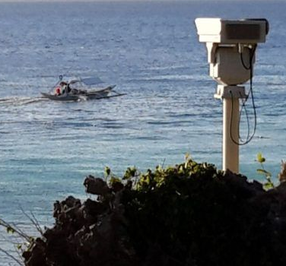
Next Steps
Coastal surveillance to identify floating objects, e.g. log, shark, illegal immigrant

Slide 27
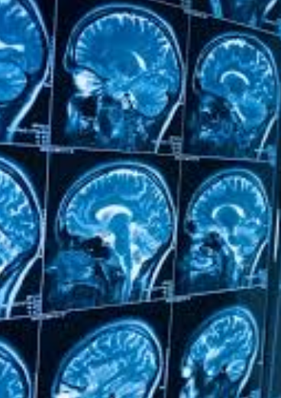
Next Steps
Anomaly detection in medical scans

Slide 28
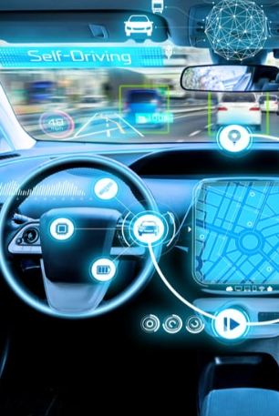
Next Steps
Autonomous vehicle to identify surrounding objects

Slide 29


Thank You
James Ng
2019-09-25
https://www.linkedin.com/in/jnyh/

Slide 30

Metis Projects
Computer Vision (CV) image classification using artificial neural network
Natural Language Processing (NLP) to analyse product reviews by online shoppers
Classification analysis on Telco customer churn
Regression analysis to predict life expectancy on a country level
Exploratory Data Analysis on NYC MTA turnstile data

Slide 31
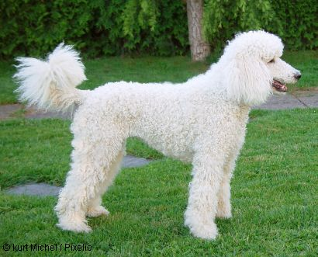


Breed identification
Miniature poodle 60.3%
Standard poodle 87.8%
Toy poodle 68.7%

Slide 32





Breed identification
Egyptian cat 77.3%
Siamese cat 99.9%
Tiger cat 36.2%
Persian cat 94.9%
Tabby cat 68.4%

Slide 33






Breed identification
Cheetah 99.3%
Leopard 98.5%
Cougar 77.8%
Lynx 99.9%
Jaguar 60.5%
Snow Leopard 92.4%

Slide 34





Breed identification
Guinea pig 99.5%
Guinea pig 99.9%
Guinea pig 99.9%
Guinea pig 72.6%
Pig 25.8%

Slide 35












Breed identification
Quail 99.6%
Black grouse 99.9%
Ptarmigan 99.9%
Bulbul 99.9%
Chickadee 99.9%
Goldfinch 99.9%
Coucal 99.9%
Hornbill 99.9%
Indigo bunting 99.9%
Jay 99.9%
Magpie 99.9%
Partridge 81.6%

Slide 36













Challenging

